Slide 1

Finding Funds to Expand Career-Enhancing Education Options

Slide 2
Session Agenda
Recent Outlook on Career-Enhancing Credentials
    What’s Out There Now?
    How Do You Fund It?
    Q & A

Slide 3
From the White House
“Occupations requiring higher educational attainment are projected to grow much faster than those with lower education requirements, with the fastest growth among occupations that require an associate’s degree or a post-secondary vocational award.” (Emphasis added)
Preparing the Workers of Today for the Jobs of Tomorrow
http://www.whitehouse.gov/assets/documents/Jobs_of_the_Future.pdf

Slide 4
From Georgetown
“In addition to these program interventions
for adults and postsecondary students who are
working, we need to revive high school career and technical education programs as alternative pathways to postsecondary education and training or to industry-based certificates and certifications that make students employable after high school.” (Emphasis added)
- Postsecondary Education and Training As We Know It Is Not Enough. http://cew.georgetown.edu/uploadedfiles/412071_postsecondary_education.pdf

Slide 5
From Washington State (I-BEST)
“The study identified a “tipping point” of at least one year of college credit and a credential as the threshold for earnings gains, to meet employer demands for skilled workers and prepare students for moving even higher in their post-secondary attainment.” (Emphasis Added)
- Washington SBCTC – Research Report No. 08-1
http://www.sbctc.edu/college/education/resh_rpt_08_1_student_achieve_basic_skills_003.pdf

Slide 6

Pathways to Prosperity Project
“27% of people with post-secondary
licenses or certificates—credentials short of
an associate’s degree—earn more than the
average bachelor’s degree recipient.”
Pathways to Prosperity (Feb. 2011)
http://www.gse.harvard.edu/news_events/features/2011/Pathways_to_Prosperity_Feb2011.pdf

Slide 7
Student Value - Employability
Top-tier staffing agency reports:
Twice as likely to be placed
50% more likely to be hired on full time
Average 10-15% higher pay
Time Magazine Report
http://www.time.com/time/magazine/article/0,9171,1952331,00.html

Slide 8
Student Value – Career Readiness
80% of entry-level information worker tasks
85% of supervisors report…
  More productive
  Require less supervision
93% Become team resources
89% Are more satisfied at work
  Keeping/staying with their jobs
"Proportionally, more kids have lost jobs in the past few years than the entire country lost in the Great Depression."
- Andrew Sum in Time Magazine
Jan 18, 2010

Slide 9
Relevance Barometers
Monster.com
Careerbuilder.com

Slide 10







Career-Enhancing Credentials

Slide 11
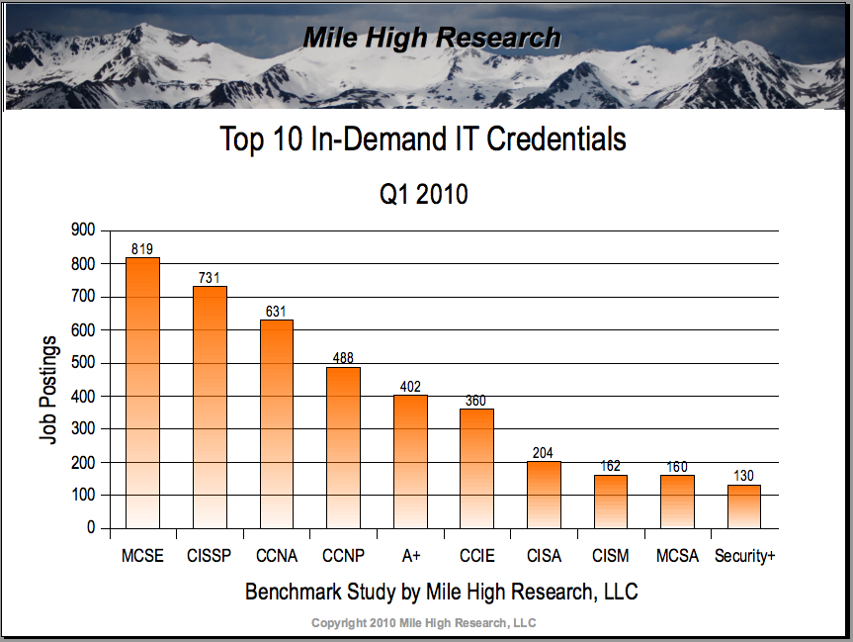

Slide 12
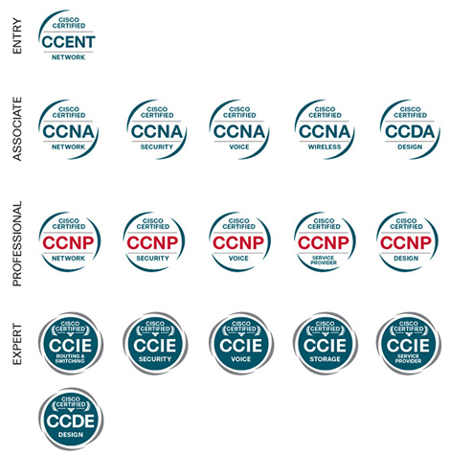
CISCO Certifications

Slide 13
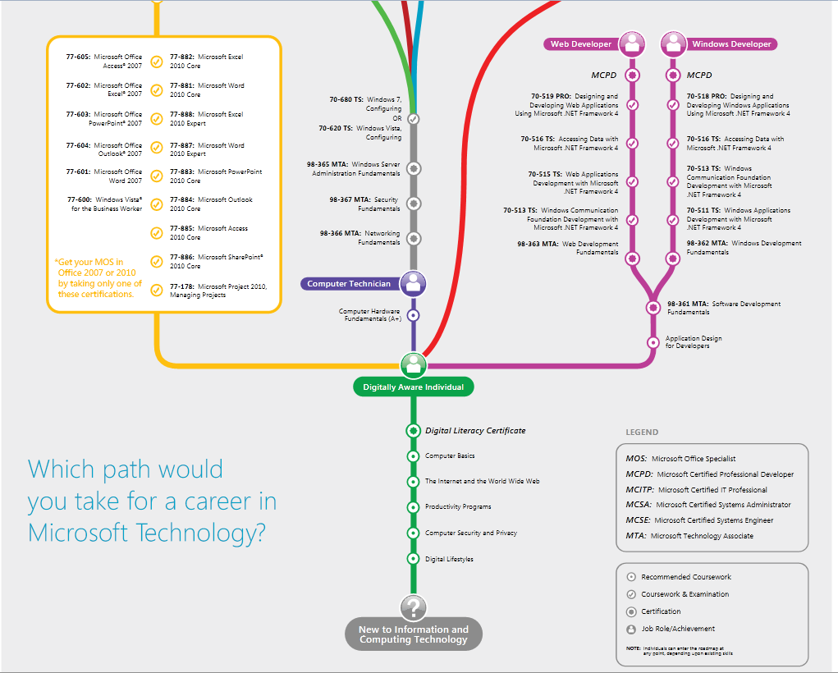

Slide 14
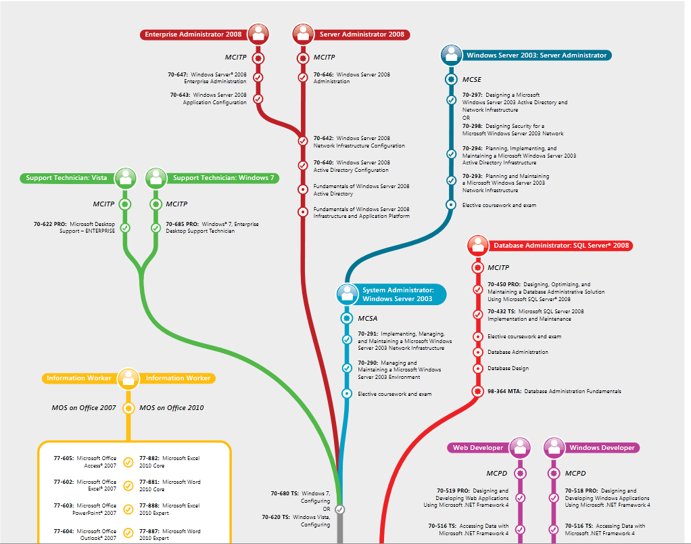

Slide 15

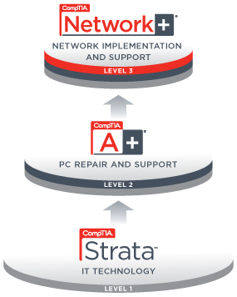



CompTIA Certifications

Slide 16
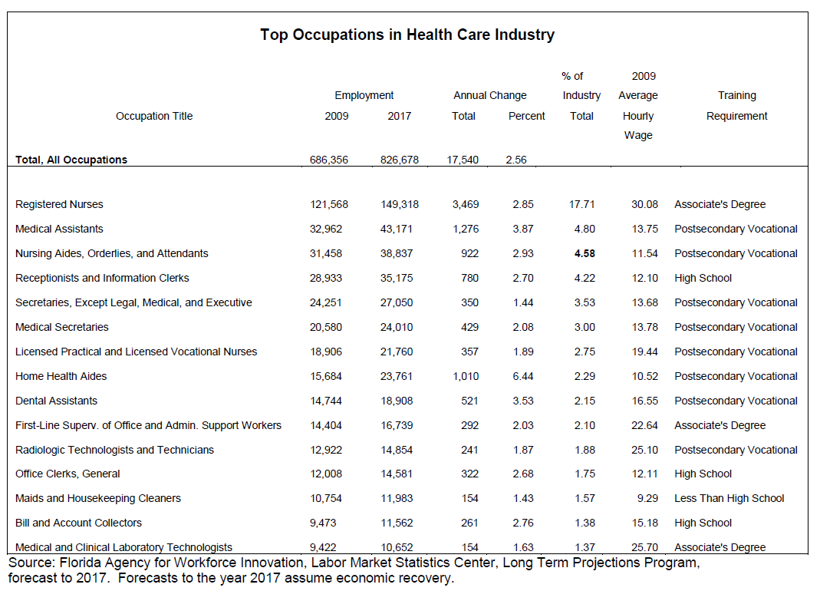

Slide 17
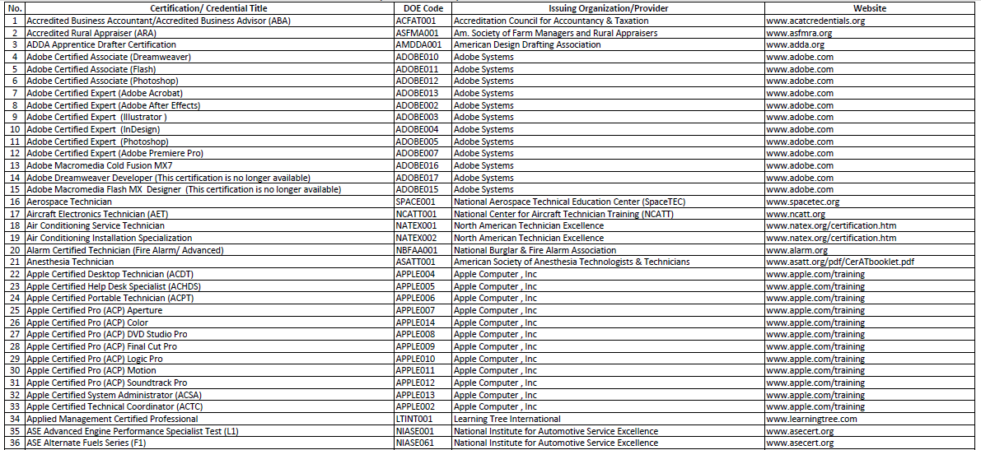
Florida CAPE Certification List
65% of all FL CAPE Certifications…
http://www.workforceflorida.com/PrioritiesInitiatives/EducationalInitiatives/cape/CAPE2010-11-FinalCondensedVersionJBupdated8-6-10.pdf

Slide 18

Funding Sources

Slide 19
General Funding Faux Pas
Gifting of State Funds
Discretionary selection
Cannot pay for additional paper certificate costs (if there are any)
Can be avoided by:
  Providing course/program/school-wide benefits (Site License)
  Understanding guidelines
  Educating those who may not understand this properly

Slide 20
General Funding Faux Pas
Misinterpretation
District/School Administration
Teachers
Can Be Avoided by:
  Going to the source
  Providing documentation to correct misdirection

Slide 21

Carl D. Perkins Funding

Slide 22
Understanding Perkins
Purpose:
Improve career-technical education programs
Integrate academic and career-technical instruction
Serve special populations
Meet gender equity needs
(www.cde.ca.gov)

Slide 23
Expanded Purpose
Develop and expand use of technology in CTE
Provide CTE Students with technical skills that lead to entry in technology fields
Enhancing/supporting accountability data for Act
(Section 135 – Local Uses of Funds)

Slide 24
Perkins Accountability
Secondary Student Indicators
Student attainment of career and technical skill proficiencies, including student achievement on technical assessments, that are aligned with industry recognized standards, if available and appropriate
(ACTE Website – Perkins Accountability)

Slide 25
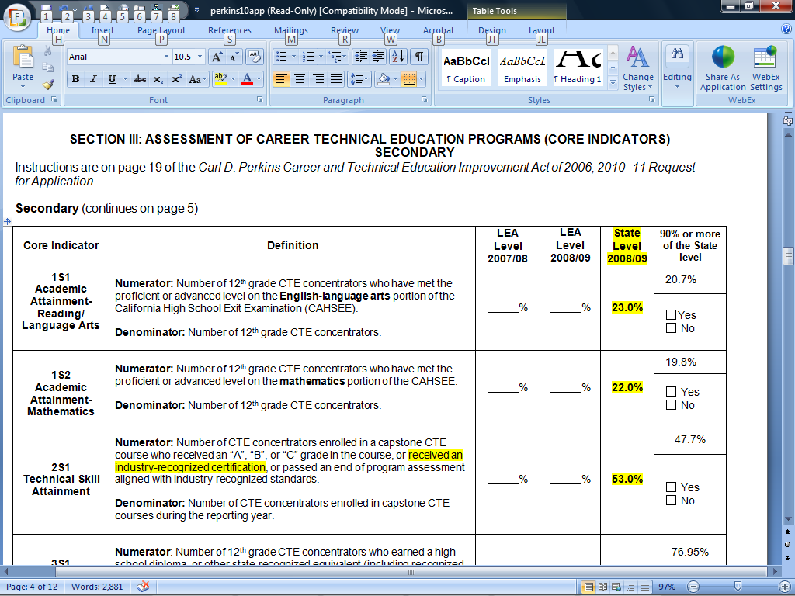

Slide 26
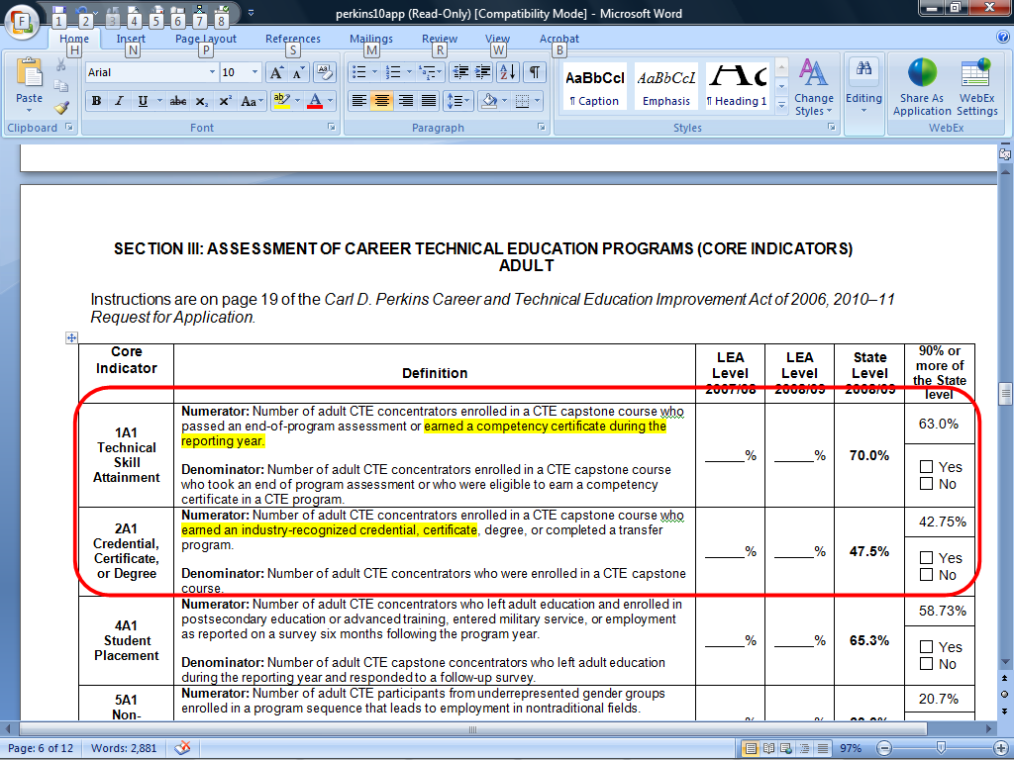

Slide 27
How To Use Perkins
Spotlight – Volunteer?
Identify industry standards & certifications to integrate into curriculum
Plan purchases for multiple years
Seek licensing/assessment models that provide universal access

Slide 28
Perkins Resources
District/School Perkins Coordinator
  Don’t hesitate to go to the source
State Office
  http://www.cde.ca.gov/ci/ct/pk/
  http://www.cde.ca.gov/ci/ct/pk/contacts.asp
    Lee Murdock – Perkins Consultant – LA Area
  (916) 445-5736
  lmurdock@cde.ca.gov
ACTE - Perkins Resources
  http://www.acteonline.org/perkins.aspx

Slide 29
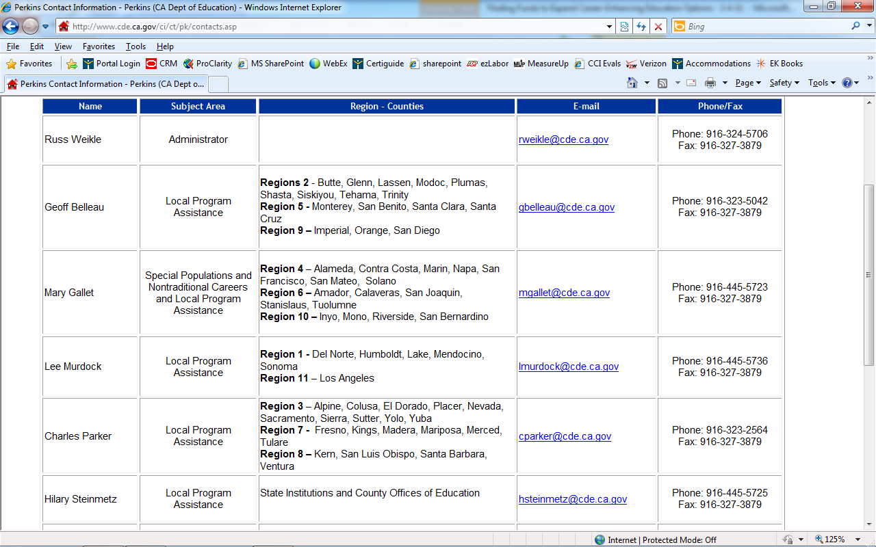

Slide 30
Enhancing Education Through Technology
(AKA: Ed Tech, E2T2, or EETT)

Slide 31
EETT Purpose
Improve student academic achievement through use of technology
Help all students become technologically literate
Integrate technology into
  Teacher Training
  Curriculum Development
  (www.cde.ca.gov)

Slide 32
How It Works
Formula Grant
Distributed at district level
Based on Local Education Agency (LEA) proportionate share of Title 1 Part A Funds
Must have CDE approved 3-5 year plan

Slide 33
How to Use EETT Funding
Work with District/School Administration
Align 3-5 year plan to Industry Standards (If language not already present)
Request needed funding from EETT Coordinator NOW for next School Year

Slide 34
Main Contact for EETT
Education Technology Office
916-323-5715
edtech@cde.ca.gov
http://www.cde.ca.gov/ls/et/ft/eett.asp

Slide 35

Ed Tech K-12 Voucher Program

Slide 36
Ed Tech K-12 VP Purpose
Implement and support education technology
Foster effective teaching practices
Promote student achievement

Slide 37
How It Works
$1.1B awarded to state of CA via lawsuit
Awards designated per school
Awards based on % free/discounted lunch program enrollment
Reimbursement program

Slide 38
How It Works
Funding split evenly into two buckets
  General Purpose Vouchers (GPV)
    Hardware
    Training/Certifications- PD
    Evaluation Tools
    IT Support Services
    Other Software Packages
  Software Vouchers (SV)

Slide 39
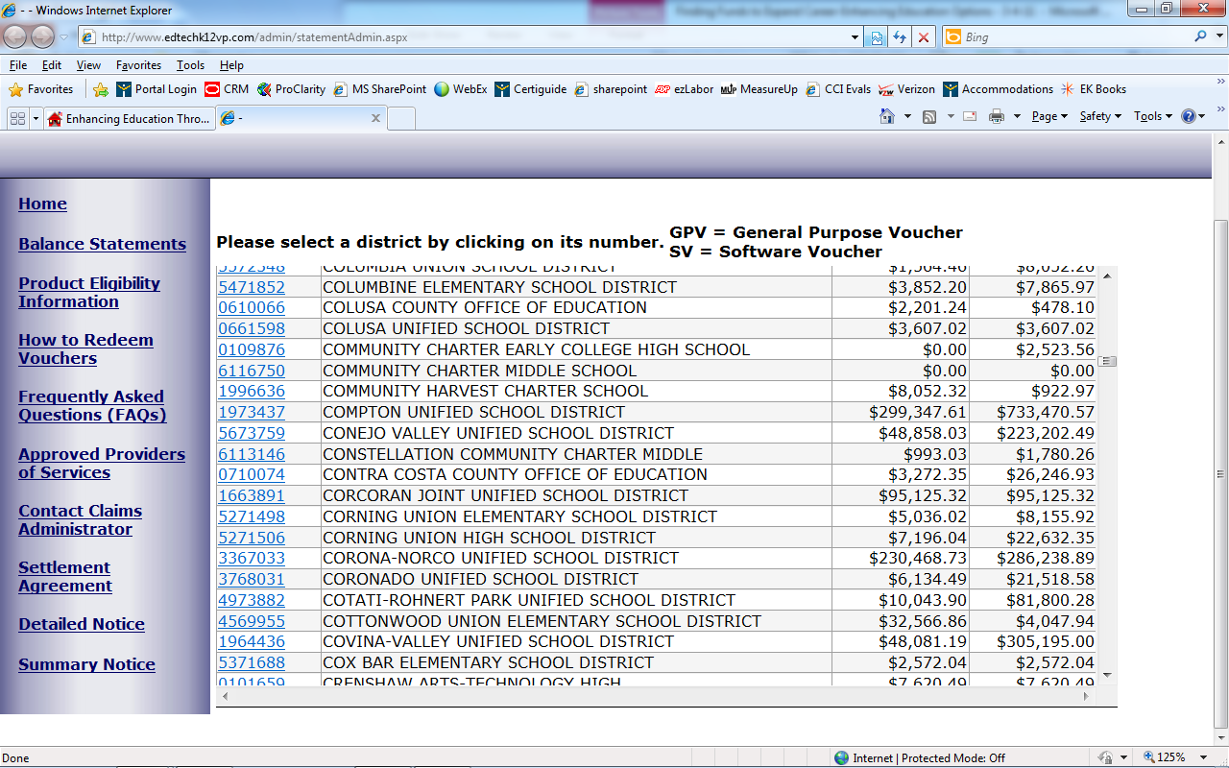
Available Balances

Slide 40
Program Expiration
Purchases Must Be Made by
September 25, 2012
Or Money Goes Away

Slide 41
Ed Tech K12 VP Resources
Dept. of Education Contact
  John Vardanega
  jvardane@cde.ca.gov
  (916) 323-2241
Program Administrator
  Call 1-800-419-5286 with questions
  Go to www.edtechk12vp.com for details & balances

Slide 42
California Partnership Academies

Slide 43

Volunteer?
How are you using CPA Funding?

Slide 44
How It Works – The Funding
Initial Grant Award Contingent Upon:
  100% School District Match
    Direct & In-Kind Support
  100% Business & Community Partners Match
    Direct & In-Kind Support
Funding = Performance Based
  80% Attendance
  90% Credit Requirement Fulfillment

Slide 45
How It Works – The Program
School-Within-A-School
“At-Risk” Students
Academic & CTE Integration
Industry Sector Focus
Business & Community Partners Co-op
    Advisory Committee
    Student Internships, Work Experience
    Mentoring

Slide 46
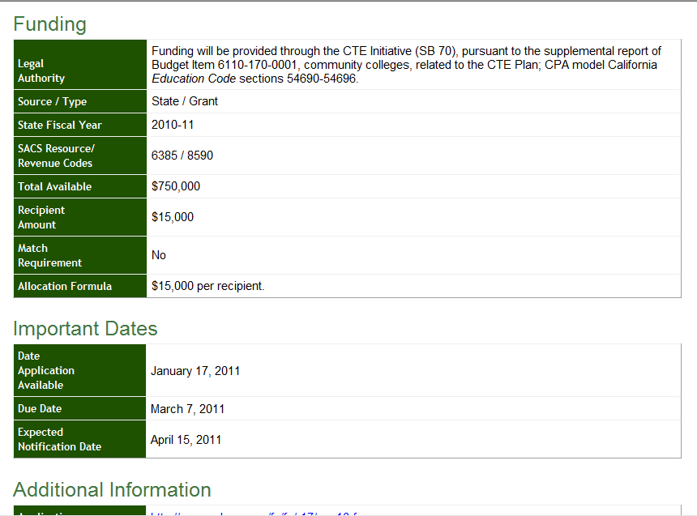

Slide 47
Tech Prep Funding

Slide 48
Funds availability
Deadline to apply has passed
BUT…
There are a lot of “Mystery” funds out there

Slide 49
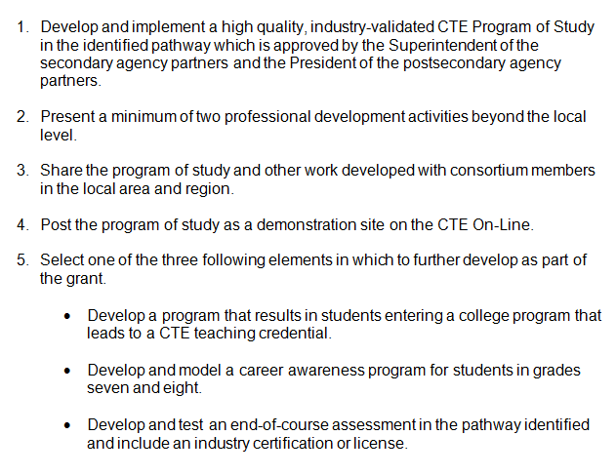

Slide 50
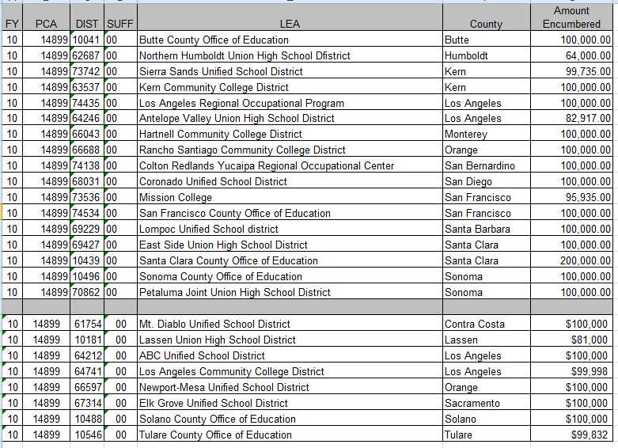
Who Received Tech Prep Funds?

Slide 51
How To Leverage Tech Prep?
Volunteer?
  Who had successfully engaged in Tech Prep?
  Roadblocks?
Contact Local Grant Recipient
  Identify their goals
  Align your program to their goals
  Collaborate to fulfill grant requirements
  Or – Seek future opportunity to collaborate

Slide 52
Other CDE Funding Options

Slide 53
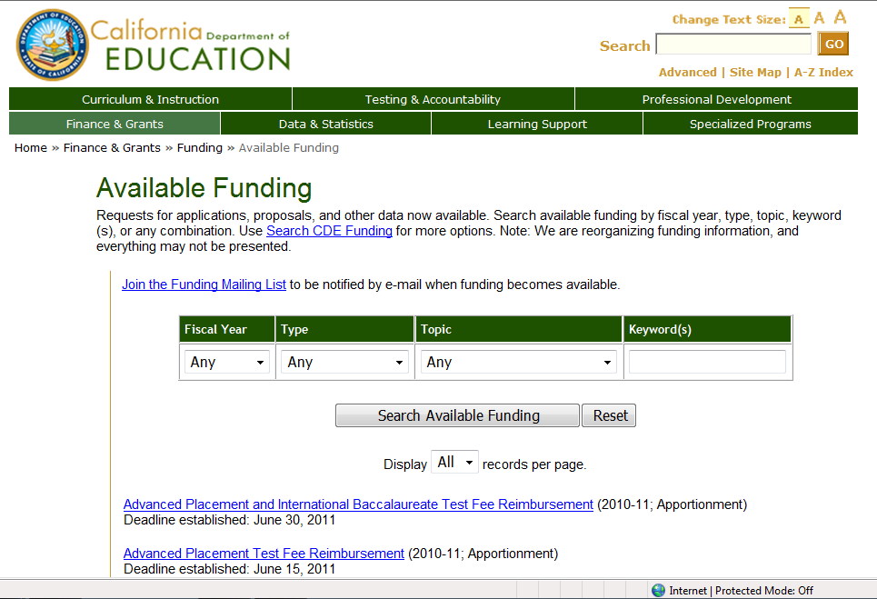

Slide 54
Local Businesses and Organizations

Slide 55
Local Businesses
Serve multiple functions
Advisory
Internships/externships
Hands-on learning opportunities
Student employment
Funding
  Any Volunteers to Share Success Here?

Slide 56
Other Funding Resources
Donors Choose
  www.donorschoose.org
  Request funding with project description
Grantmakers for Education
  http://www.edfunders.org/index.asp
Bill & Melinda Gates Foundation
US DOE (Slim Pickings, but they’re out there)
  http://www2.ed.gov/fund/grant/apply/grantapps/index.html
PTA

Slide 57
Thank You!
 | Dave Hansen Director, Product Operations - Microsoft MCT, MMI, CPI, IC3 AI, MOS, CompTIA Strata Direct Line: 801.847.3167 Toll Free: 888.999.9830 x167 Mobile: 801.369.3109 Email: dhansen@certiport.com

